Slide 1

Medallia
Customer Feedback Analysis:
Triangle Select Program
May 1, 2023

Slide 2
Triangle Select Program Medallia Observations
Objective: Research any relevant information in Medallia regarding Triangle Select's registration process.
Search Criteria: Date range: [June 18, 2022 – May 1, 2023], NPS: ‘Likelihood to Recommend Score’, Search words: “Triangle Select”, “registration”, “sign up”
Dataset: Tracking 43 comments.
Top Themes and Findings Summary:
Technical Issues: Difficulties with signing up for Triangle Select, including error messages, slow loading times, and glitches.
Navigation: Challenges navigating the Triangle Select Dashboard, specifically viewing earning details and accessing premium subscription program features and viewing flyers.
Shipping Costs: Customers are expressing frustration with Canadian Tire’s high shipping costs, and one suggested the company wave the shipping cost for purchases over a certain amount.
Gift Card: Customers are experiencing delays in receiving their $50 gift card from the program, and unsatisfactory customer support on the issue.
Customer Support: Challenges with enrollment and lack of customer support in Triangle Select program.

Slide 3
Theme Volume Tracker
Total Comments: 43

Slide 4
The majority of user feedback reported technical difficulties with logging in and encountering error messages before or after completing the registration process.
Theme: Technical issues
Customer comments | Key Notes
“Can't join Triangle select. I tried 3 times and I keep getting [Sorry! There was a technical problem. Please refresh the page to Join Triangle Select again]” | Unsuccessful in joining due to a technical error message. Customer [QM session Link]
“I'm not very happy with the way that the sign up for Triangle Select has been working for me. I follow the link to sign up & I get no response or I get a blank page. I have been trying to sign up since my membership needed to be renewed. This should not be if there is another way to renew I am not aware of this. Thank you for your time.” | Multiple failed attempts to sign up due to encountering a blank page. Customer needed their membership to be renewed, but is not aware of any other methods.

Slide 5
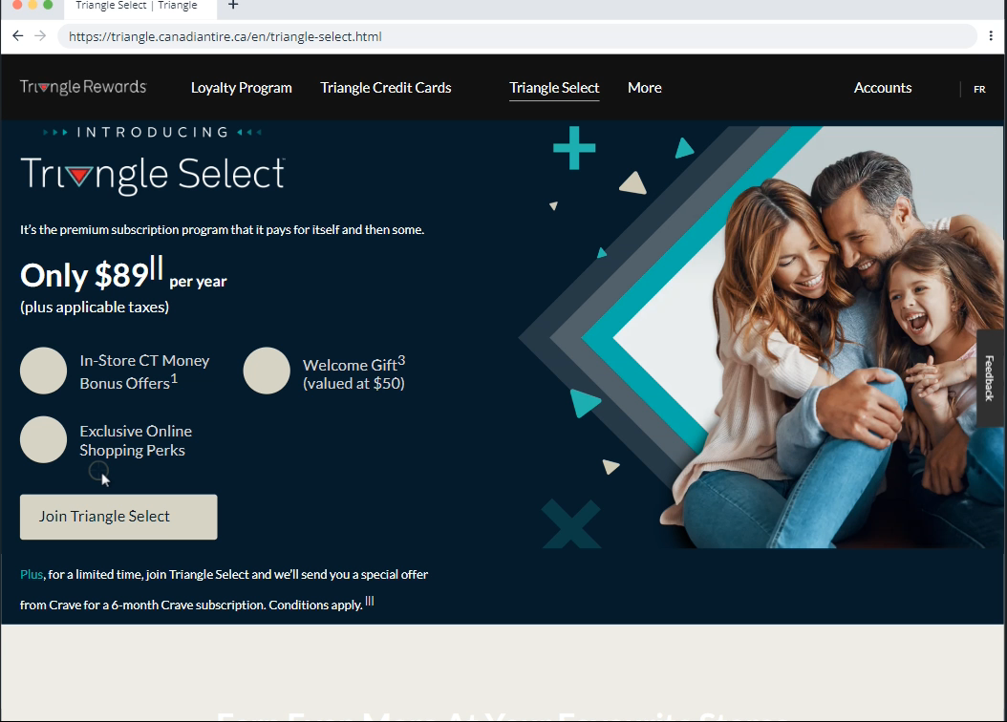
Below is a QM video of a user making repeated attempts to join by clicking on "Join Triangle Select," but encountered the same error message:
Technical issues
Video [QM Link]

Slide 6
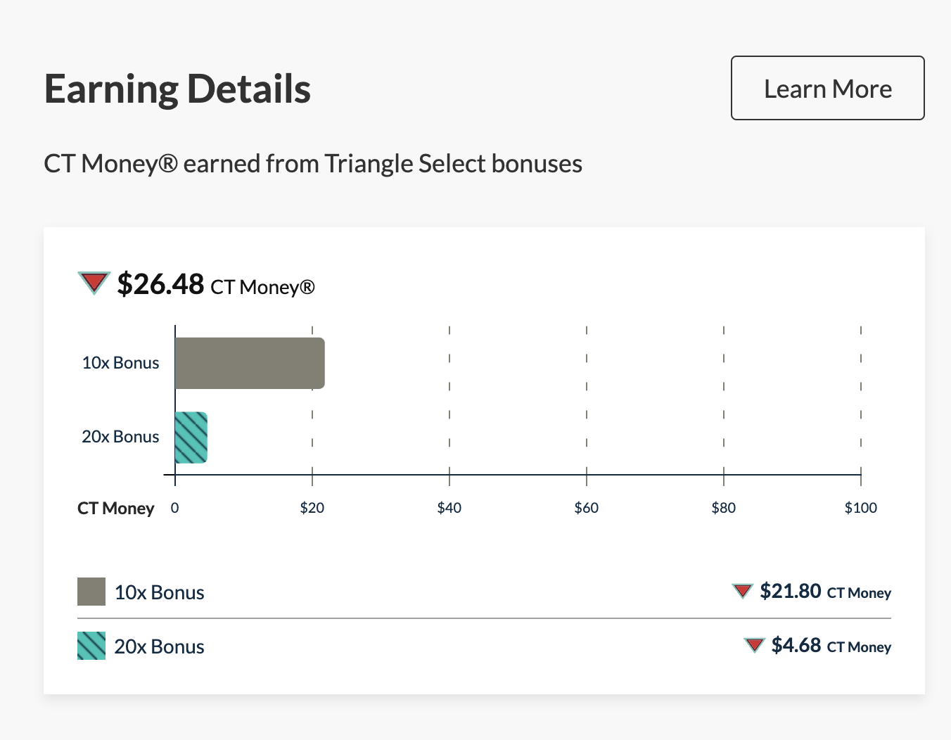
Some users expressed confusion regarding the new Triangle Select program’s Earning details. More specifically, they would like to see a more detailed breakdown of their earnings.
Theme: Navigation
Customer Comments
“With the new Triangle Select it wasn't clear what I earned as points under the new system or even with the 20x Bonus Day.”
“I can't see the detail about my earnings. I can't see the following amount. I must call Triangle Canadian Tire Representative 10$, 1.26, 3.18, .84, .40, .22, .89, .21. I can see only the following on my account or my Invoice. 5,16$ Triangle SELECT 4,44 Base Cash PLEASE display details earnings over the Web site account.”

Slide 7
Customers expressed frustration with Canadian Tire’s high shipping costs, and one suggested the company wave the shipping cost for purchases over a certain amount.
Theme: Shipping Costs
Customer Comments | Key Notes
“The initial shipping cost was estimated around $16, as soon as I entered my Triangle credit card it automatically changed shipping to $43 but I got $20 off since I'm a Triangle Select subscription member. NOT a great reason to have a Triangle Select subscription. Also, why is the option to ship to my store not available?” | Shipping cost increased from the initial estimate, but received a $20 discount as a Triangle Select subscriber. User would like a “ship to store” option available.
“If I didn't want the rewards to buy something from sports check I would have gone to Walmart. Better website, better product availability, and much less shipping. How the hell does shipping cost 25$ don't you care at all about your customers. Even triangle select is a joke... making it seem like you're reimbursing the shipping fees but you only give back up to $12. What a joke do you even care if people shop here. I chose to go online because the bay and Dundas store is a joke. There is product everywhere and you can barley walk about the store and one of their door when covid ended a year ago. I thought the online store would be a better alternative but it's made me realize Canadian Tire is becoming a joke brand based on these experiences.” | Customer compares CT unfavorably to Walmart, citing lower shipping costs. Customer feels that the Triangle Select program reimbursement is not sufficient enough.

Slide 8
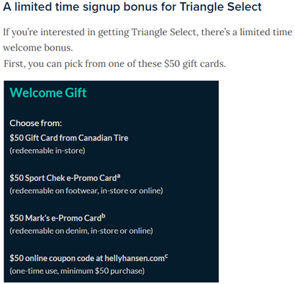
Customers are experiencing delays in receiving their $50 gift card from the program, and unsatisfactory customer support on the issue.
Theme: Gift Card
Customer Comments
“We signed up for the Triangle Select Program, choosing the $50 Gift Card from Canadian Tire. We have yet to receive said gift card. Please look into the delay. Thank you, Robert Karas”
“I cannot find an answer for my question. When I emailed specifically about it they told me it involved personal information and couldn’t answer. I just want to know if the triangle select program special gift of $50 to use in store is a gift card mailed out or some sort of code I’m supposed to track down. Triangle select has been nothing but hassle so far!”

Slide 9
Users reported unsatisfactory experiences with customer support when attempting to resolve issues with the Triangle Select program.
Theme: Customer support
Customer Comments | Key Notes
“I have been trying for weeks to join the Triangle Select program. I have called and talked to customer service a few times, I have emailed, I have filled out the online help forms. No one seems to understand what the program is or why I keep getting errors. I even went into the store and saw the huge posters you have put up - but customer service said they have NO information and can't even check my card to let me know if am in or not for the program.” | This user experienced a failure in multiple touchpoints of the omnichannel experience.

